Slide 1
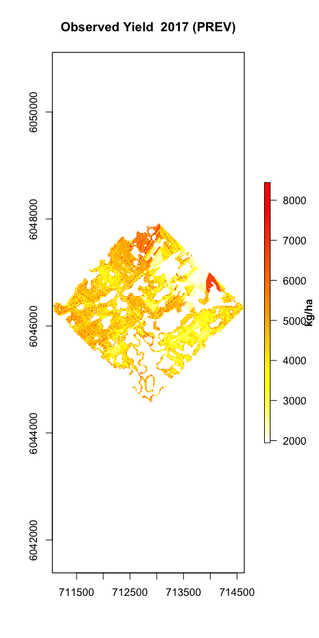
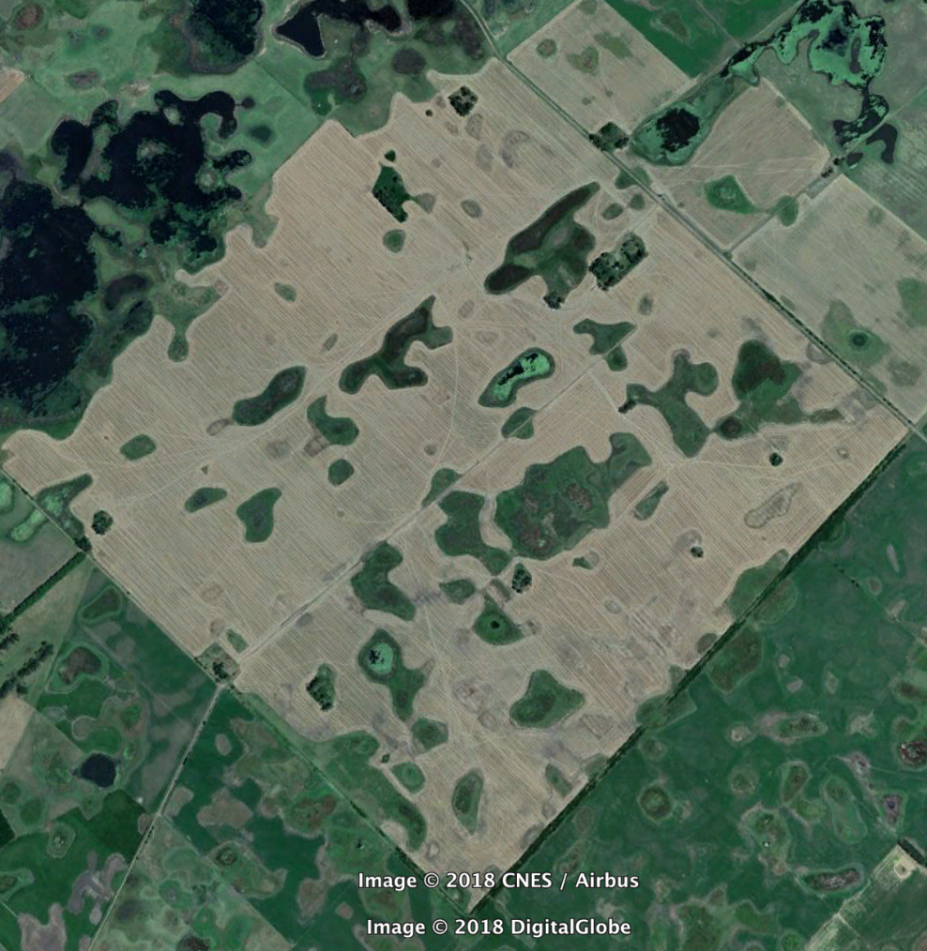
Field: oeste25 Year: 2017 Crop: winter wheat

Slide 2
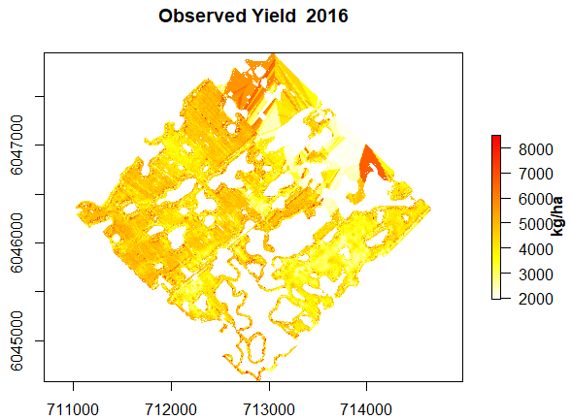
Farm: Oeste Field: 25 Year: 2016 Crop: ?

Slide 3
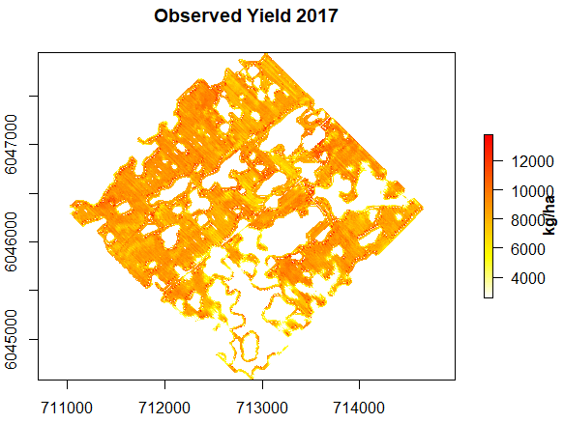
Farm: Oeste Field: 25 Year: 2017 Crop: winter wheat

Slide 4
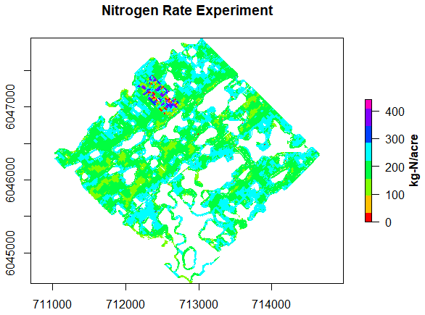
Farm: Oeste Field: 25 Year: 2017 Crop: winter wheat

Slide 5
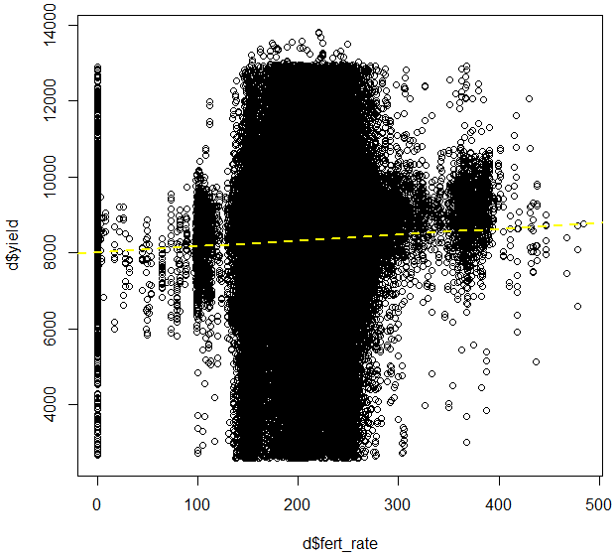
Raw data with data rows with fertilizer rates above 500 kg/ha removed
Linear fit through data with just fert_rate as predictor = significant
R² = 0.0017

Slide 6
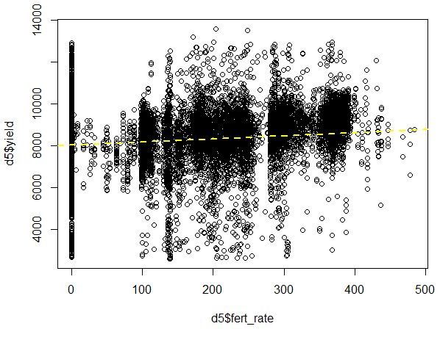
Farm: Oeste Field: 25 Year: 2018 Crop: winter wheat
Data rows with fertilizer rates above 500 kg/ha removed and ~16,000 random rows with fertilizer rates between 140 and 280 kg/ha removed
Linear fit through reduced data with just fert_rate as predictor = sign.
R² = 0.052

Slide 7
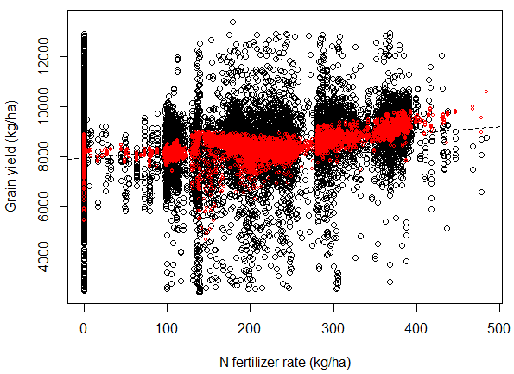
Farm: Oeste Field: 25 Year: 2018 Crop: winter wheat
Multiple linear regression with all significant predictors:
Yield = β₀ + β₁ * N + β₂ * N² + β₃ * prevYield + β₄ * elev + β₅ * ec30 + β₆ * ec90
R² = 0.13

Slide 8
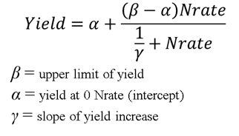
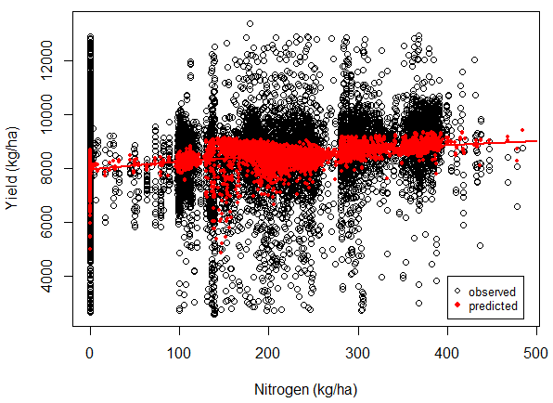
Farm: Oeste Field: 25 Year: 2018 Crop: winter wheat
Nonlinear fit:
α = β₀ + β₁ * elev + β₂ * ec30 + β₃ * ec90
β = β₀ + β₁ * prev_yl
γ = 0.001 locked in for analysis
R² = 0.119

Slide 9
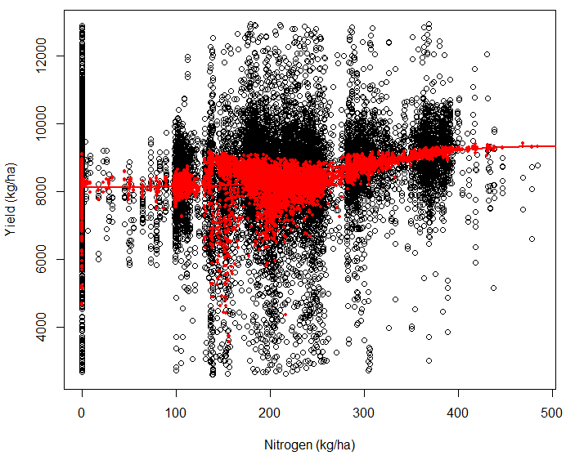
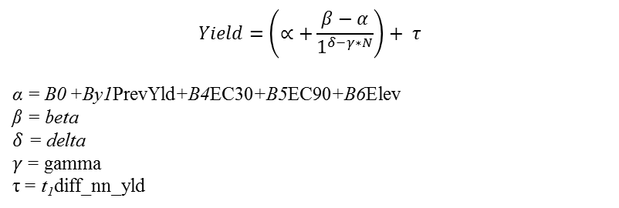
Farm: Oeste Field: 25 Year: 2018 Crop: winter wheat
$$Yield=\left(∝+\frac{β−α}{1^{δ−γ∗N}}\right)+ τ$$
α = B0 +By1PrevYld+B4EC30+B5EC90+B6Elev
β = beta
$δ$ = delta
$γ$ = gamma
τ = t₁diff_nn_yld
Sigmoid function
R² = 0.126

Slide 10
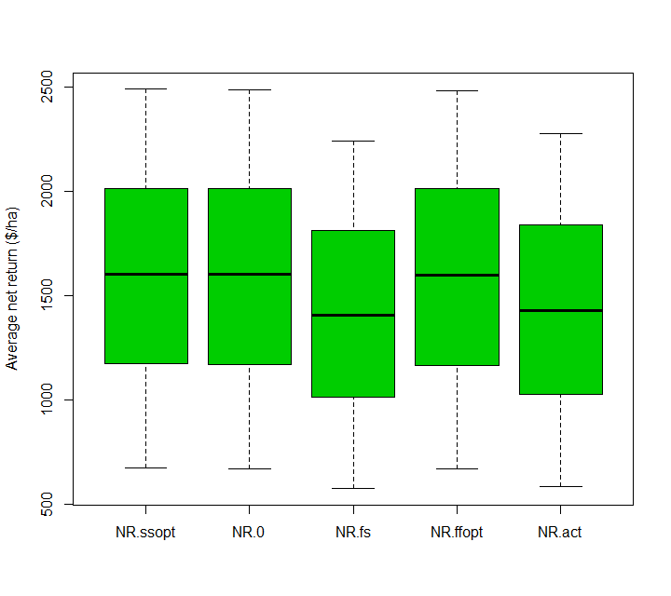
NR.ssopt>NR.0 NR.ssopt>NR.fs NR.ssopt>NR.ffopt NR.ssopt>NR.act
Probability 1.0 1.0 1.0 1.0

Slide 11
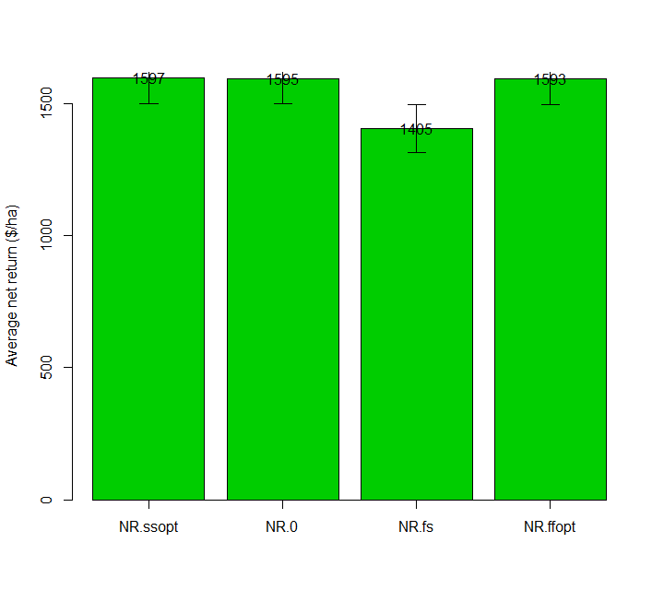

Slide 12
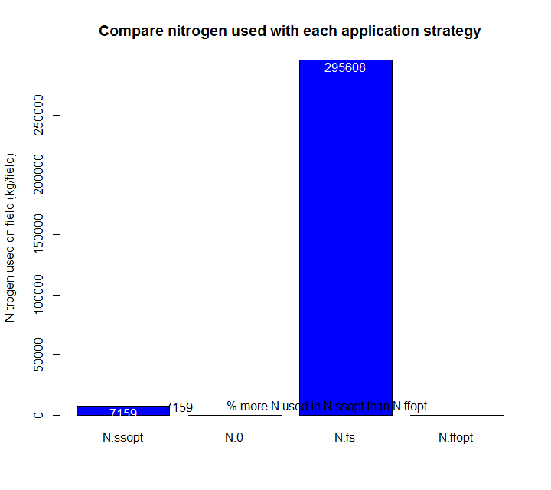

Slide 13
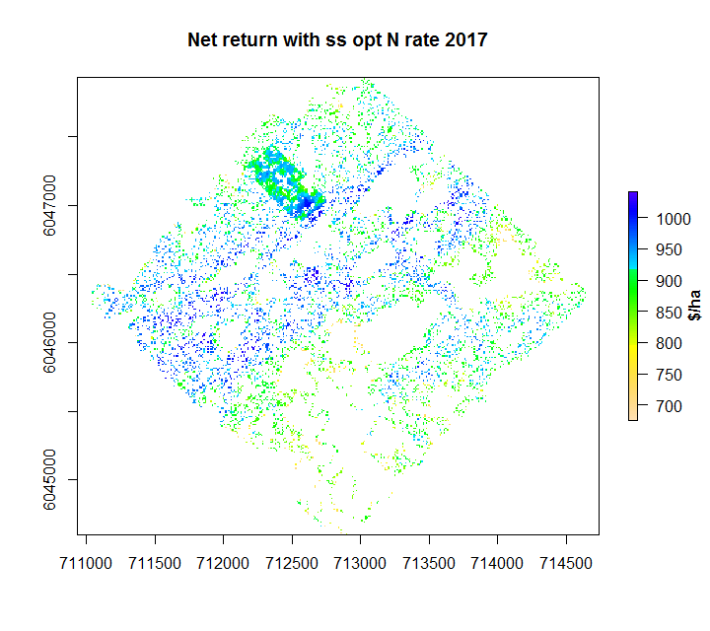

Slide 14
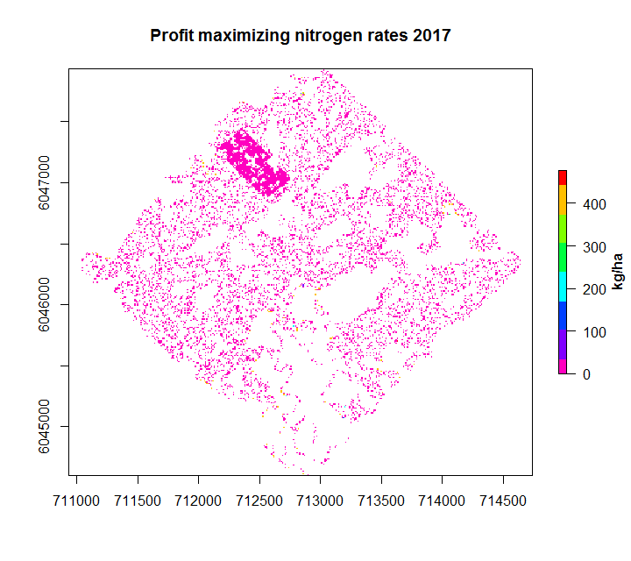

Slide 15
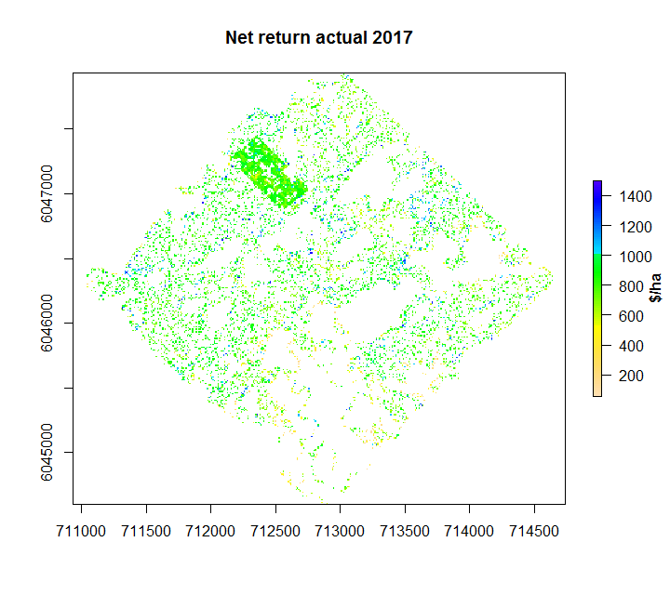
Cost of the experiment

